Slide 1
Dynamic Work Assignment for GEMMs on AMD GPUs
Muhammad Osama, Alex Dutu & Ryan Swann, RAD
Building on Concurologist-NV Learnings and Recommendations by Shaizeen and Mohamed & Freemont / Tesla Investigations from 2025 by
Guennadi, Epherem, Guihong, Vikram and others!

Slide 2
Problem Statement
HBM
LLC
XCD
Interconnect
XCD
LLC
HBM
gemm
L2
L2
L2
L2
HBM
XCD
XCD
HBM
Interconnect
Interconnect
AID
AID
HBM
LLC
XCD
Interconnect
XCD
LLC
HBM
Understanding the performance loss of GEMMs when executing alongside communication kernels versus GEMMs run in isolation.
e.g. if a torch.distributed.all_reduce uses 32 workgroups launched on 32 CUs on an MI300X GPU with 304 CUs, GEMM running concurrently only experiences a performance loss of ~11% (272 available CUs instead of 304).
L2
L2
L2
L2
HBM
XCD
XCD
HBM
gemm
HBM
LLC
XCD
Interconnect
XCD
LLC
HBM
L2
L2
L2
L2
HBM
XCD
XCD
HBM
Interconnect
Interconnect
comm
AID
AID
HBM
LLC
XCD
Interconnect
XCD
LLC
HBM
CPU
GPU1
GPU2
GPU3
L2
L2
L2
L2
HBM
XCD
XCD
HBM
TIME

Slide 3
Performance Issues w/ Concurrent GEMM & Comm Kernels
Tail Latency Effect (wave quantization)
As we increase the number of available resources the latency will not reduce unless there is an even distribution of work with same work quantum.
If the same work quantum is used, kernel performance will not be a linear function of resources, but rather a stepwise function.
Work Distribution Across XCDs and SEs
WG dispatching order (round robin between XCDs) can introduce low utilization of resources, because CUs are released out of order.
Faux CU allocation granularity of 32 (or 8 – with CP FW workaround) CUs, which leads to unequal distribution of work.
L2 and MALL Thrashing
When GEMM and Comm memory footprint exceeds the L2/MALL capacity.
HBM and Network Contention

Slide 4
1. Tail Latency Effect (Wave Quantization)
OCCUPANCY
OCCUPANCY
100%
50%
timestep₀
timestep₁
For a 4 Tile problem, we achieve perfect utilization (100%) on our hypothetical GPU.
However, if we just had 2 more tiles, our occupancy for 2nd timestep will be only 50% and our total utilization ceiling will be 75%.
This problem is known as “wave” quantization, where the wave refers to the timesteps (and not wavefronts in AMD GPUs).
CU₀
CU₁
UNUSED RESOURCES!
CU₂
🚀Stream-K Schedule Explained & Animated
By Kapil Sharma @ Meta
CU₃

Slide 5
2. Work distribution across XCD and SEs
Unusable CUs because of WG dispatching implementation in MI3**X
Asymmetric CU harvesting
Variable dispatch starting point among SEs
Static partitioning of CUs
CU masking further exacerbates the unusable-CUs effect
The SE WG dispatch counters are not updated based on the CU mask
The CP just reads the CC_GC_SHADER_ARRAY_CONFIG register once
CC_GC_SHADER_ARRAY_CONFIG specifies only the physically available CUs, not the CUs marked as usable by the mask

Slide 6
Workgroup Dispatching
Assuming
a grid of 40 WGs
starting to dispatch from SE 3
WGs dispatch round-robin between SEs
Counters decrement w/ WG dispatch
When a counter reaches 0
a dummy WG is dispatched to current SE
a second WG is dispatched to the next SE
In this way WGs are dispatched to the last CUs in SE[1, 2]
SE 0
SE 1
SE 2
SE 3
CU
CU
CU
CU
CU
CU
CU
CU
CU
CU
CU
CU
CU
CU
CU
CU
CU
CU
CU
CU
CU
CU
CU
CU
CU
CU
CU
CU
CU
CU
CU
CU
CU
CU
CU
CU
CU
CU
CU
CU
counter = 9
counter = 10
counter = 10
counter = 9
Dispatch dummy WG,
counter == 0
Dispatch dummy WG,
counter == 0

Slide 7
Workgroup Dispatching w/ CU Masking
Assuming
a grid of 19 WGs
starting to dispatch from SE 3
only 19 CUs available, via CU masking
SE0 – 5 CUs, SE1 – 5 CUs, SE2 – 5 CUs, SE3 – 4 CUs,
Counters are still initialized from CC_GC_SHADER_ARRAY_CONFIG, which does not consider the CU mask
counters will never reach 0
dummy WGs are not dispatched
After 4 WGs are dispatched to all 4 SEs
SE3 will have no CU available
but no dummy WG will be dispatched to SE 3
the SE 3 counter will be 5 != 0
SE 0
SE 1
SE 2
SE 3
CU
CU
CU
CU
CU
CU
CU
CU
CU
CU
CU
CU
CU
CU
CU
CU
CU
CU
CU
CU
CU
CU
CU
CU
CU
CU
CU
CU
CU
CU
CU
CU
CU
CU
CU
CU
CU
CU
CU
CU
counter = 9
counter = 10
counter = 10
counter = 9
The baton will not be passed to the next SE/SPI!
WG dispatching will stop at SE3, after 4 WGs/SE!
However, SE[0, 1, 2] each have one CU available!

Slide 8
Work Stealing-based GEMM
# Sub-partition within the XCD across COUNTERS_PER_XCD slots.
tiles_per_slot = tl.cdiv(tiles_this_xcd, COUNTERS_PER_XCD)
slot_base = slot * tiles_per_slot # relative to xcd_base
slot_end = tl.minimum(slot_base + tiles_per_slot, tiles_this_xcd)
tiles_this_slot = slot_end - slot_base
# Counter for this XCD + slot
counter_ptr = tile_counter + xcd_id * COUNTERS_PER_XCD + slot
local_tile_idx = tl.atomic_add(counter_ptr, 1, scope="gpu")
while local_tile_idx < tiles_this_slot:
# Map slot-local index → global tile_id
tile_id = xcd_base + slot_base + local_tile_idx
# GROUP_SIZE_M swizzle → (pid_m, pid_n)
num_pid_in_group = GROUP_SIZE_M * num_pid_n
@triton.jit()
def ws_matmul( A, B, C, ...):
pid = tl.program_id(0)
# Per-XCD work-stealing with multiple counter slots
# PIDs are round-robin across XCDs: 0→XCD0, 1→XCD1, …
xcd_id = pid % NUM_XCDS
local_wg_id = pid // NUM_XCDS # WG index within this XCD
slot = local_wg_id % COUNTERS_PER_XCD
# Partition tiles into contiguous per-XCD regions.
tiles_per_xcd = tl.cdiv(total_tiles, NUM_XCDS)
xcd_base = xcd_id * tiles_per_xcd
xcd_end = tl.minimum(xcd_base + tiles_per_xcd, total_tiles)
tiles_this_xcd = xcd_end - xcd_base

Slide 9
Work Stealing-based GEMM
+1
+1
TILE COUNTER
XCD₀
XCD₁
TILE COUNTER
High-level description;
Use atomic_add to increment a counter in global memory.
Returned value of the atomic increment is your current tile id.
Features;
Global counter (1 counter for all CUs),
Counter-per-XCD (1 or N counters for each CU per XCD).
Backend: Origami’s Solution Selection + Triton
Launch Options;
Grid = Number of CUs
Grid = Number of Tiles
tile_id
XCD₃
TILE COUNTER
+1
Work-Stealing-based Persistent Kernel: https://github.com/ROCm/tritonBLAS/pull/64

Slide 10
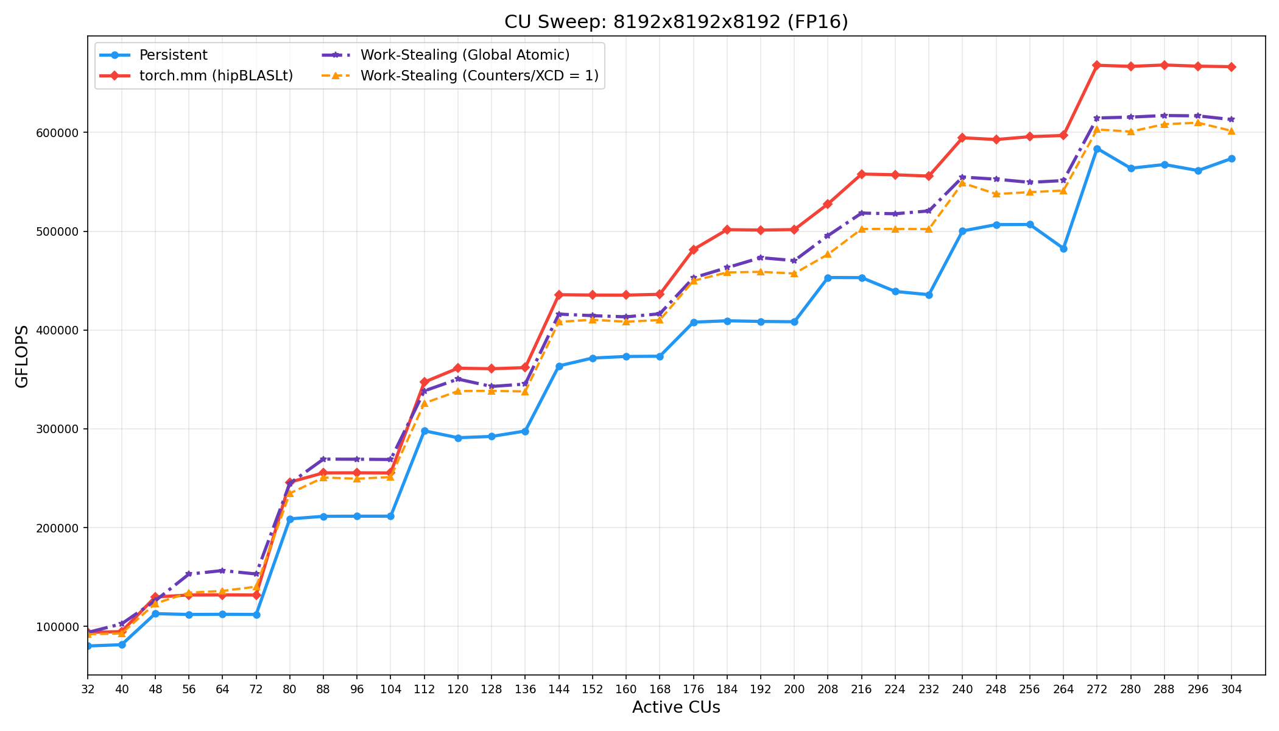
Work Stealing-based GEMM on MI300X (8K^3)
Some improvements in CU count 112, 120, 128, 144.
Tail Latency (wave quantization) problem still exists for GEMM running in isolation.

Slide 11
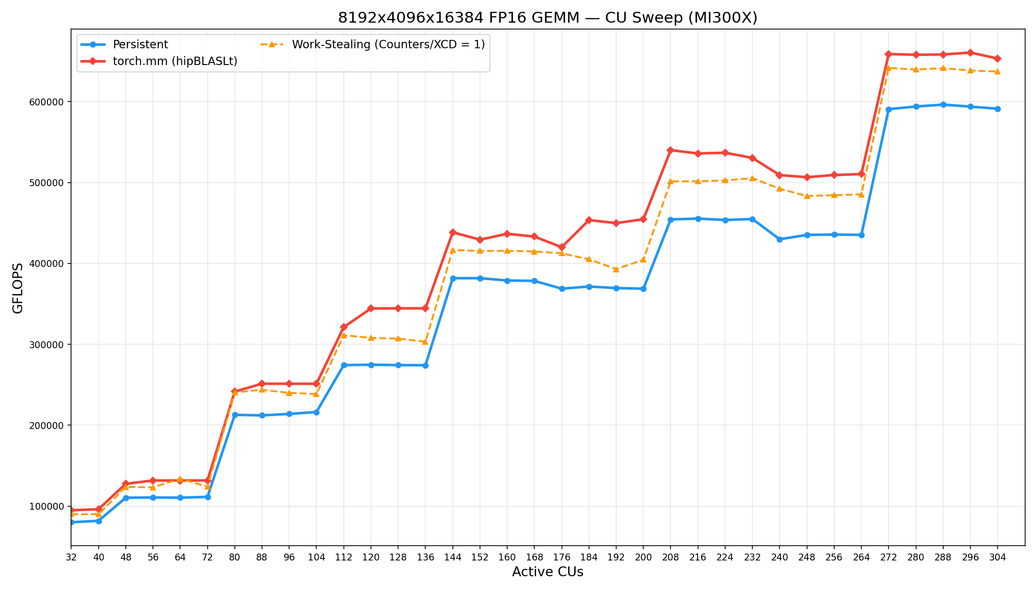
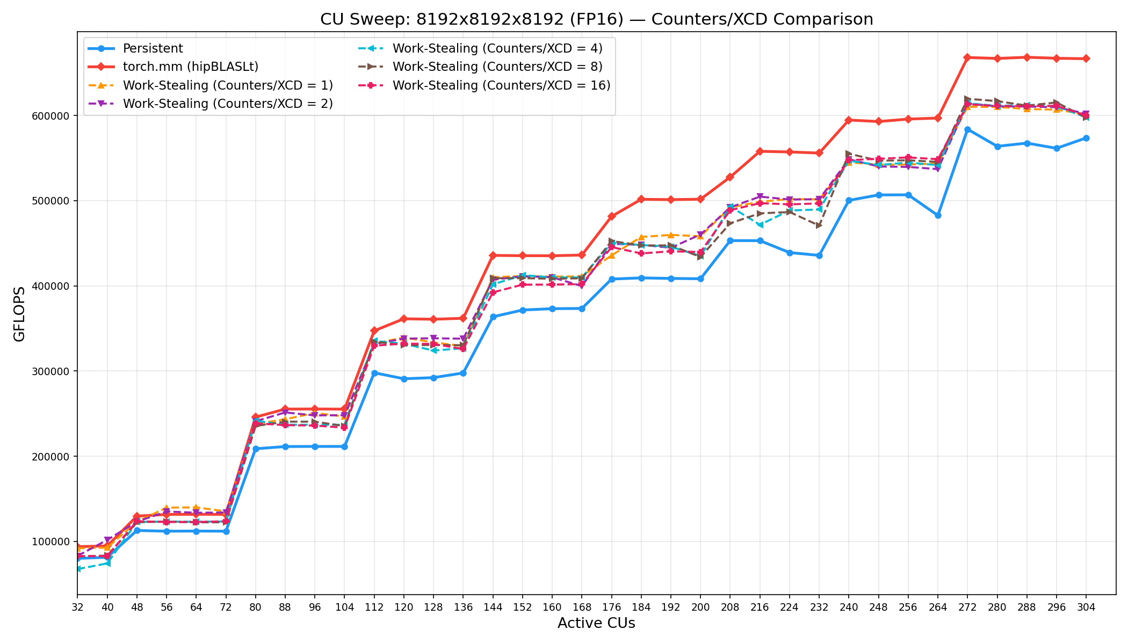
Work Stealing-based GEMM on MI300X

Slide 12
3. L2 and MALL Thrashing

Slide 13
4. HBM and Network Contention

Slide 15
Origami
New MT_M, MT_N, MT_K, WGM?
New WGM
M, N, K, N_CU
Origami
Kernel Phase 0
Kernel Phase 1
MT_M, MT_N, MT_K
grid, WGM
New N_CU

